Slide 1
Team 2: Emoji Administration
Aaron Lewis, Young Kim, Stephen Agbenu, Mohamed Bouh, Matthew Rinoldo

Slide 2
Purpose
Display list of users
Edit user information
Set/change text schedule for that user
Display emoji response data
Graphs, charts, etc
Export emoji response data as CSV file

Slide 3
Platform
Java Desktop application
GUI using JavaFX
Interface with AWS database managed by Team 9
Class considerations
Read from/Write to AWS
Generate CSV file from data
Send email to administrators

Slide 4
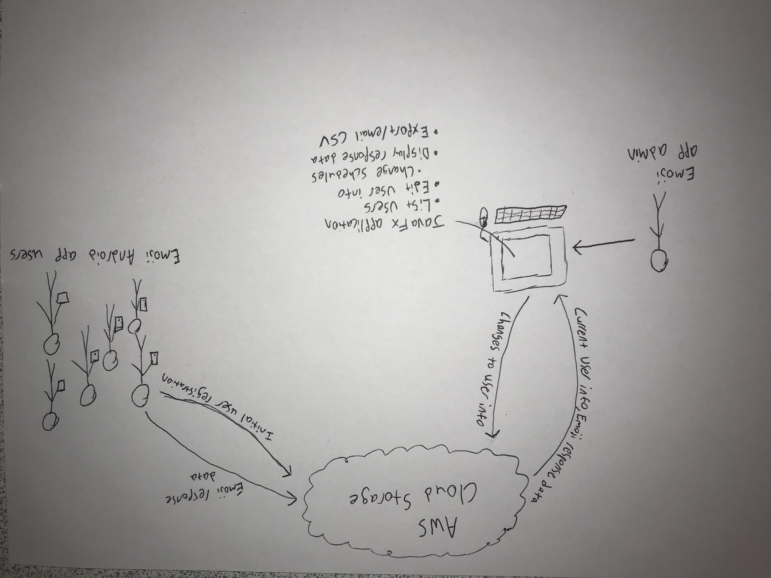
Conceptual Model

Slide 5
StoryBoard

Slide 6
Story 1: Java and Amazon Web Service Interaction
Connected through the AWS SDK for Java
Has needed repositories for database connection
Usage of separate class to determine data fields in database
Can edit (ex. remove, add, or fetch usernames)

Slide 7
Story 2: Data Exportation (Csv)
Data exported from AWS database needs to be turned into a easily manipulated, parse-able format
CSV format will be used due to it being commonly used, easily read, and easily manipulated
Many options are available, mostly likely will use opencsv framework
Retrieved data can be directly exported to csv or it can be mapped to java objects, which can be further manipulated based on specific needs

Slide 8
Story 3: Desktop Application
Allows the Admin to access all the user information in a user-friendly GUI
Can edit information through this application (editing the database information from here)
Must be able to send users the emoji feeling checker messages
Has to be able to check times of previous messages and responses
Export a readily-available CSV Sheet
Organized by separating into user info, message sending, time stamp, and export data sections (but not pretty)
Basically, this is the “front-end” part of the project where the administrator (non-coder) can do all the task

Slide 9
Story 4: Administrative App Communication with Amazon Web Services
All user data will be stored in Amazon Web Services.
An administrative UI will be used to query the AWS database using the AWS SDK.
Administrators will be able to query specific users, time periods, emotions, or general statistics.
This deals with the relationship between the desktop application and the AWS database, in terms of information stored and fetched
Similar to Story 1, but how vs. what (in terms of Java)

Slide 10
Story 5: Cross-Team Development
Due to this project being cross-team, some cooperation is needed
Other projects are the android app and the backend system
Database (backend) Issues
Access to database
Data fields used
Information transfer
Android Application Issues
Compatibility
Synchronize

Slide 11
Thanks!

